Slide 1
Research Fundamental Idea

Slide 2
The Paper
Automation of
Data Analysis in
Formula 1 Racing
A Data-Driven Analysis of
Formula 1 Car Races Outcome
Data Analysis
using Python
Hardware
Data Gathering
Data Analysis
Race Outcomes
Framework
PCA Methodology
Correlation Data
Improve Strategies
Why Python
Libraries
Data Analysis Steps
Visualization Data

Slide 3
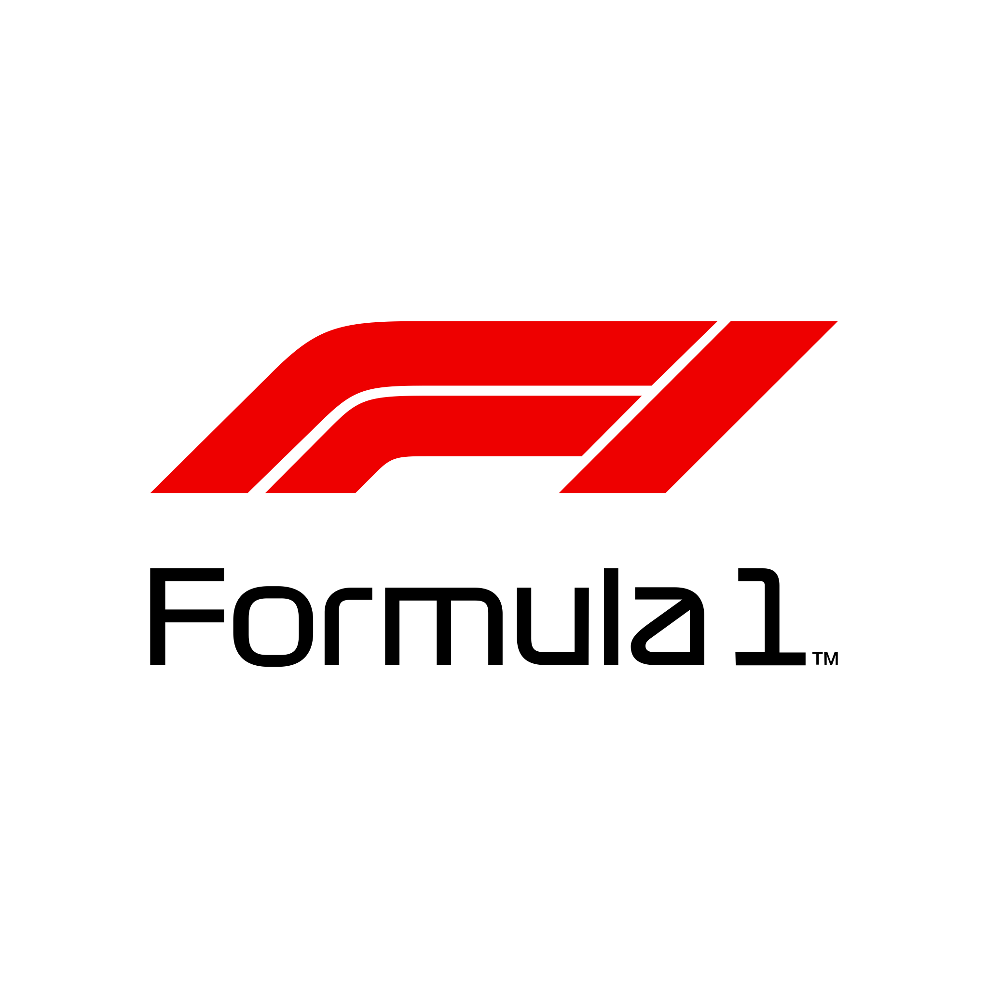
What is F1?
Formula One is a motorsport with fast and advanced cars. 10 teams competing around the globe to win the championship.
Winning in Formula One is determined by many factors such as driver skills, car performance, and strategy crafted from the team.
F1 is a mix of innovation, skills, and teamwork which make it one of the most exciting and thrilling motor racing competitions in the world.

Slide 4
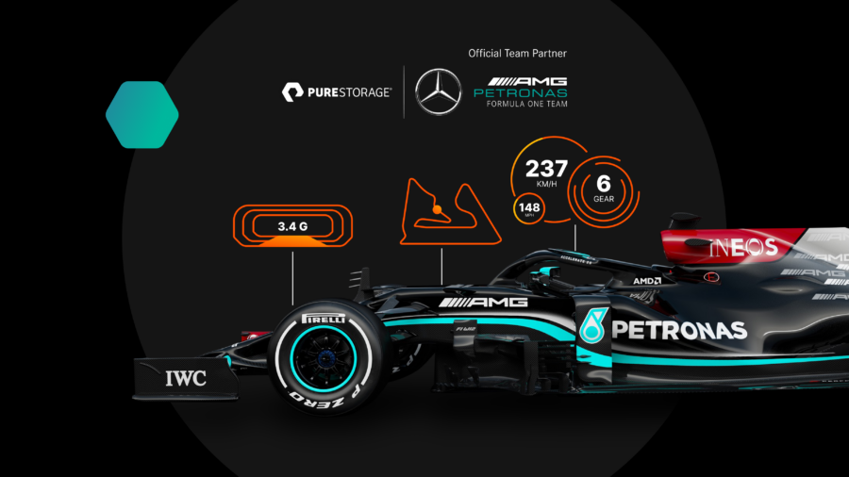
Automation of Data Analysis in Formula 1 Racing
Hardware / Data Gathering
Build with high precision
More than 200 Sensors - G-Force Sensors - Tire Temperature and Pressure - Driver Biometric - Steering Angle Sensor
Driver’s Feedback
Over 1TB of data per race per car

Slide 5
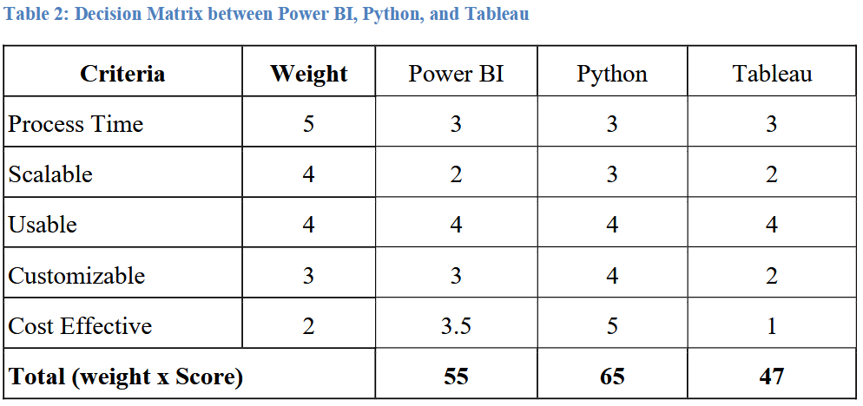
Automation of Data Analysis in Formula 1 Racing
Data Analysis Tool
Process Time
Scalable
Usable
Customizable
Cost Effective

Slide 6
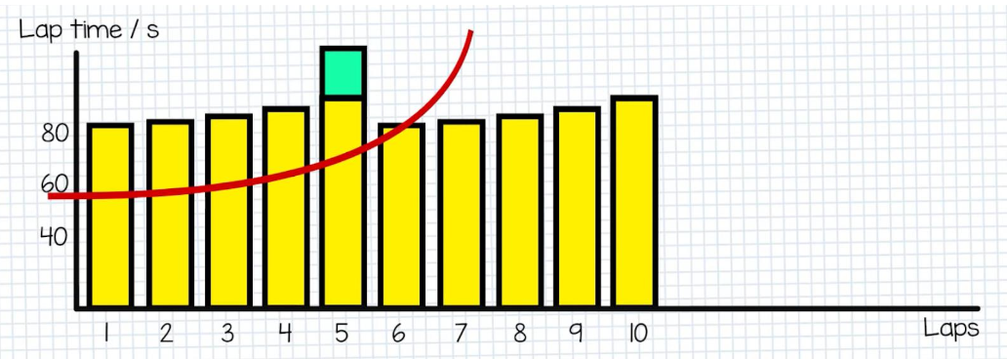
Automation of Data Analysis in Formula 1 Racing
Outcome
Best Pit Time
Tire Management
Risk Management
Performance Optimization

Slide 7

A Data-Driven Analysis of Formula 1 Car Races Outcome
Principal Component Analysis (PCA)
Linear Dimensionality Reduction
Principal Component Analysis
Simplified Complex Data
Dimensionality Reduction
Preserve Variability
Remove Noise
Pattern

Slide 8
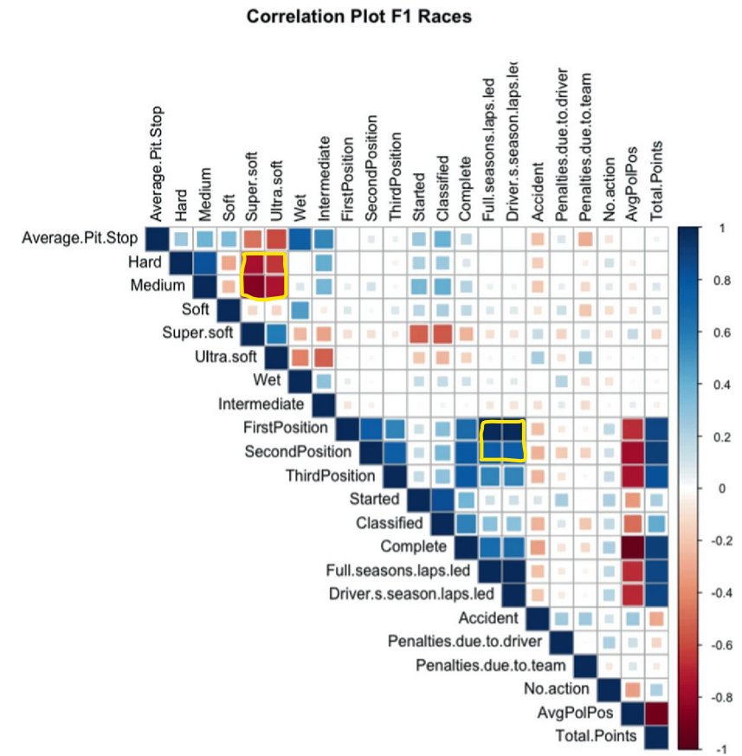
A Data-Driven Analysis of Formula 1 Car Races Outcome
Correlation Data
Different tires have different purpose.
Finishing first tend to mean you are more likely to be the race leader.
Data from 2015 - 2019

Slide 9

Data Analysis using Python
Why Python
High Level Language (Easy to use)
Lots of documentation
Tons of Libraries
High Versatility

Slide 10
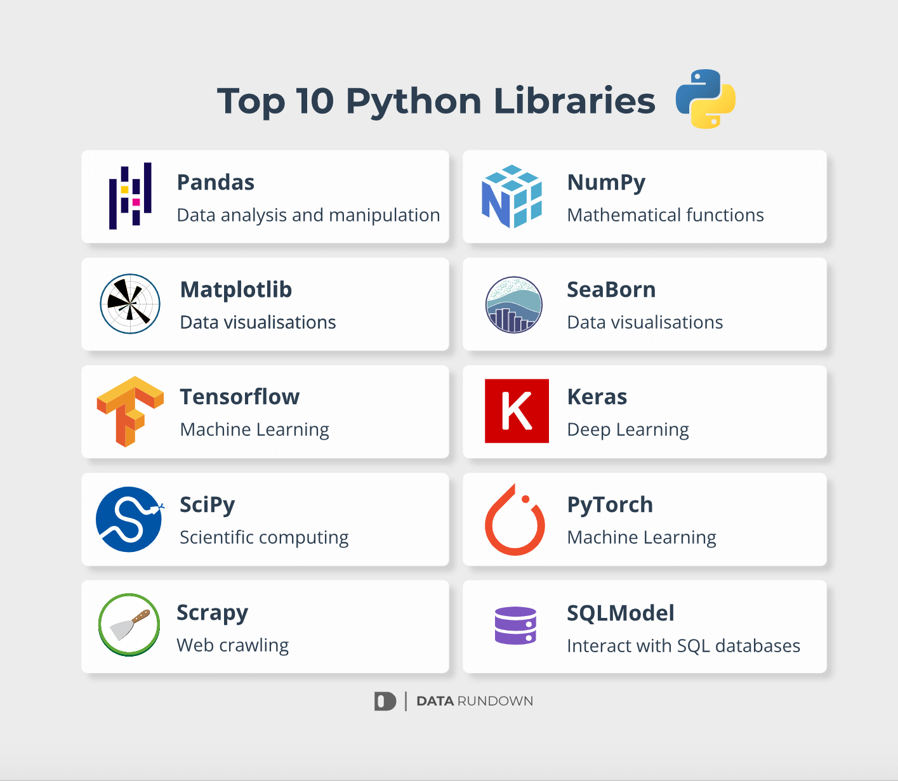
Data Analysis using Python
Libraries
Numpy: Mathematical Functions, and Numerical Computing.
Pandas: Data analysis and Data Manipulation
Matplotlib: Data Visualization
Seaborn: Uses Matplotlib, but simpler with more attractive visualization.

Slide 11

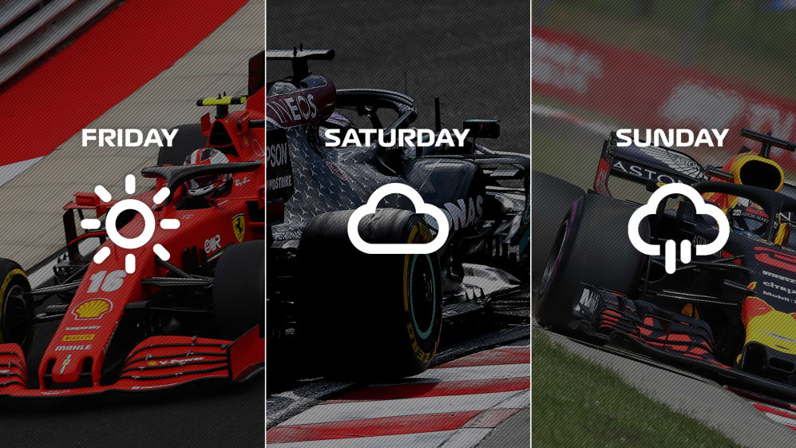
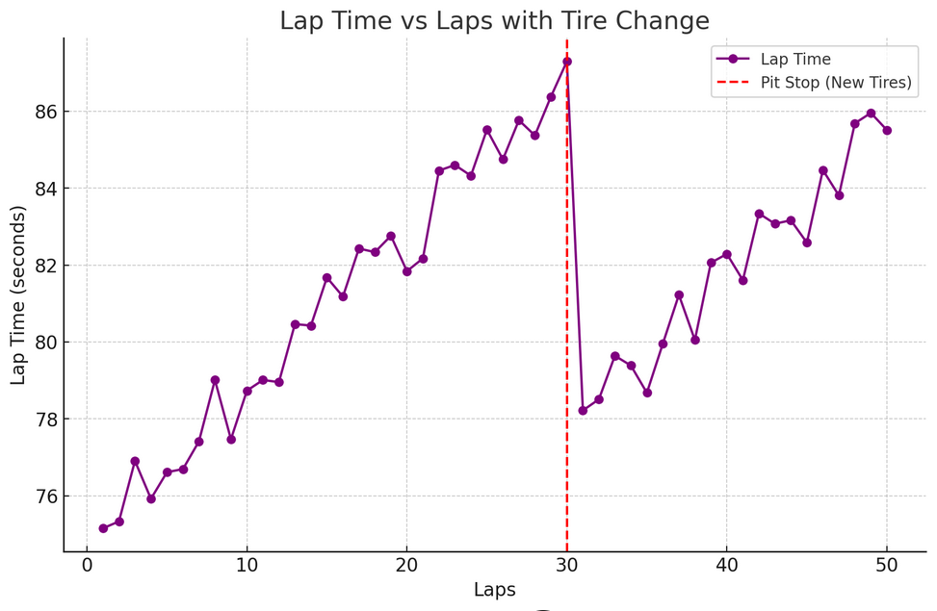
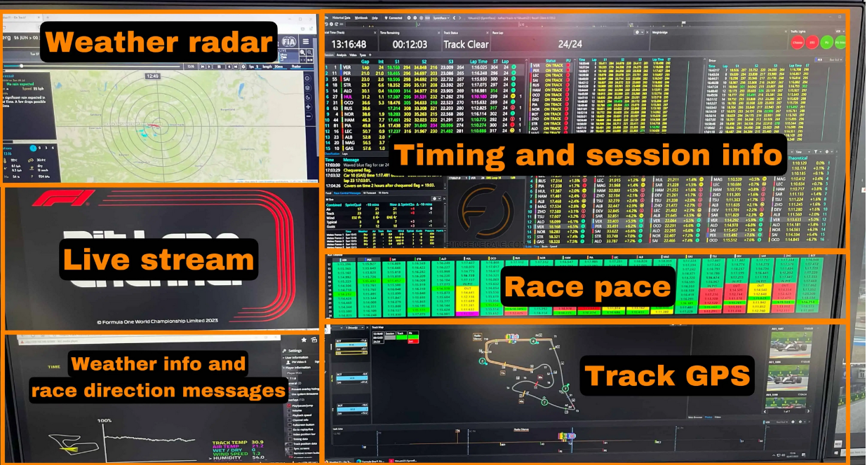
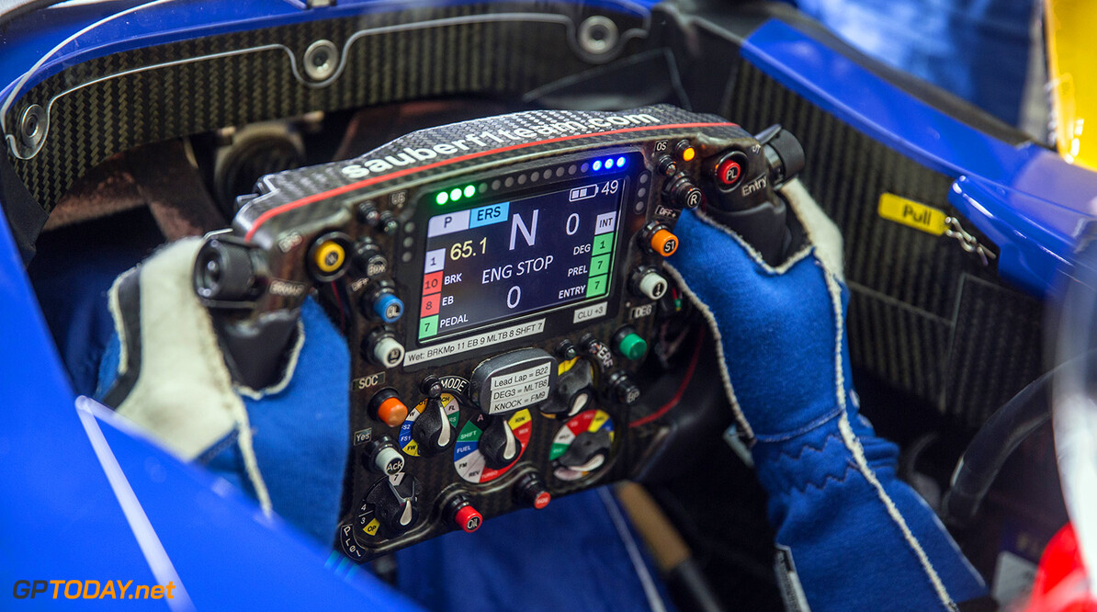


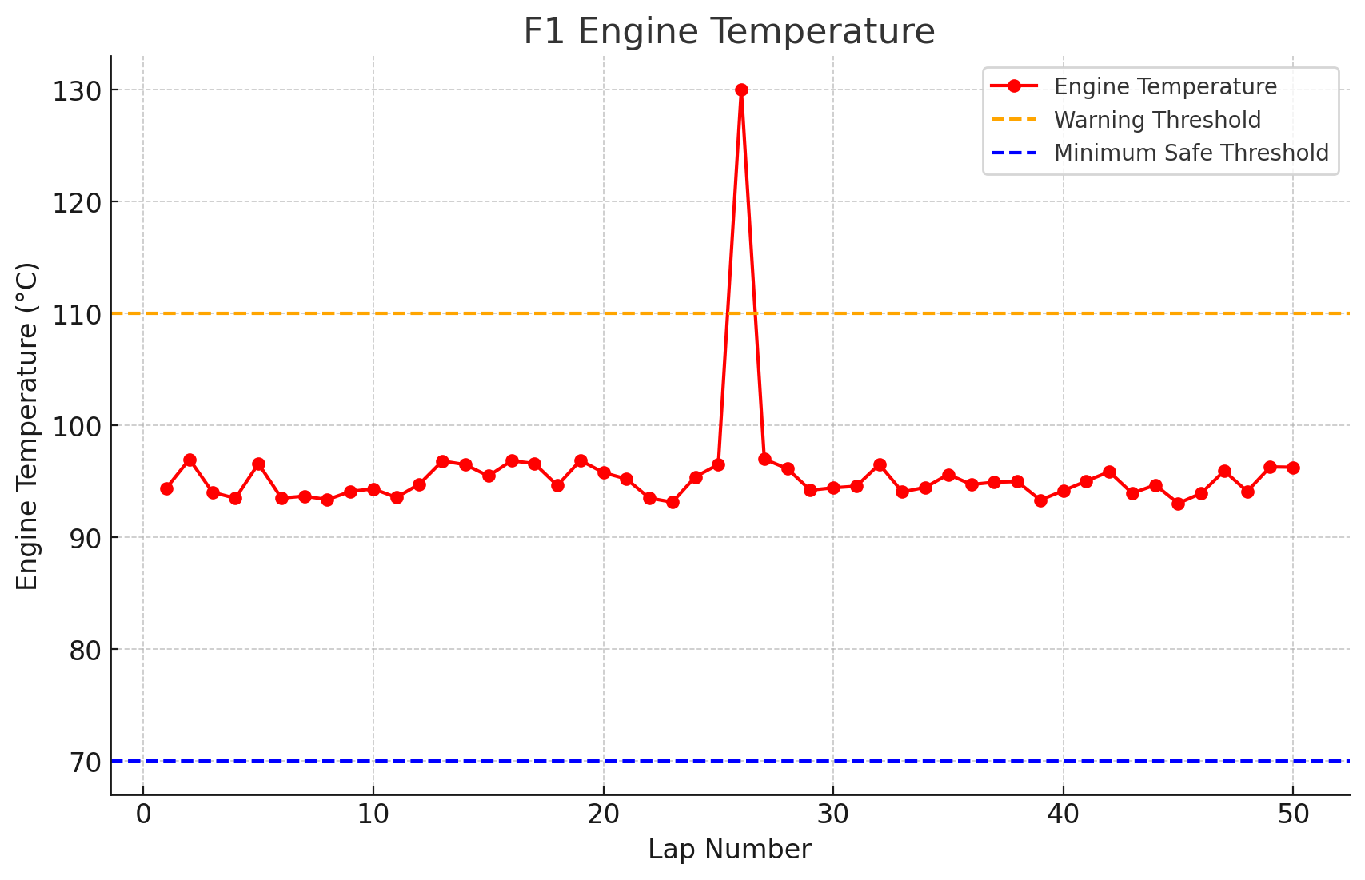
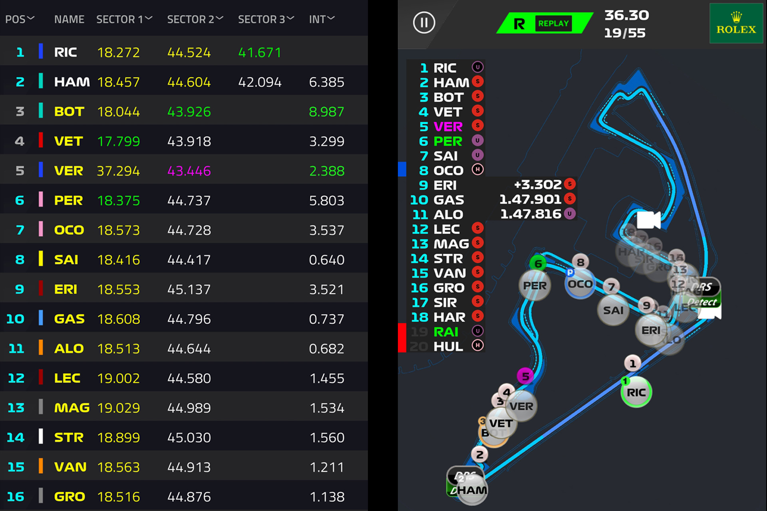

Data Analysis using Python - Data Analysis Steps
Data is crucial for any study, and must be aligned with the analysis requirements.
Data must be organized for analysis, e.g putting the data into a database such as Microsoft Excel.
Data can now be analyzed, and understand the message, finding the average, median, etc. Data visualization is also a common technique used here.
This can be an application that takes data as input, processes it using a model or algorithm to produce usable output, this output will then be used for decision making, automation, and others.
Data
Requirements
Data Collecting
Data Processing
Data Cleaning
Exploratory Data Analysis
Modeling and Algorithm
Data Product
Data can be gathered from many kinds of sources, e.g individual testing, cloud data, and other sources.
Remove data that is duplicated, errors, outlier data, and sometimes inconsistencies depending on the case.
Algorithms may be applied to the data in order to find the relationship among the variables.

Slide 12
Reference
A Data-Driven Analysis of Formula 1 Car Races Outcome
AUTOMATION OF DATA ANALYSIS IN FORMULA 1
Data Analysis In Python

